Slide 1
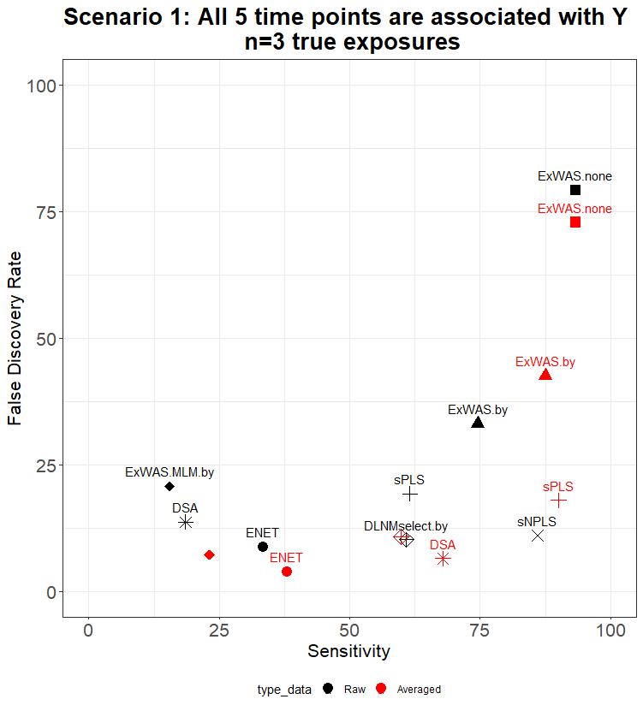
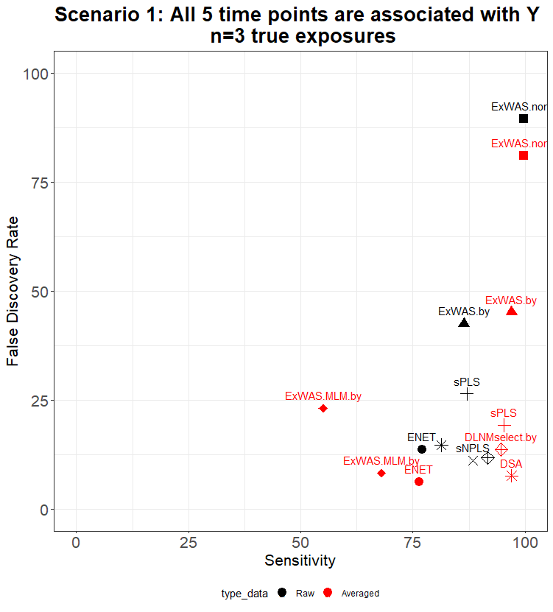
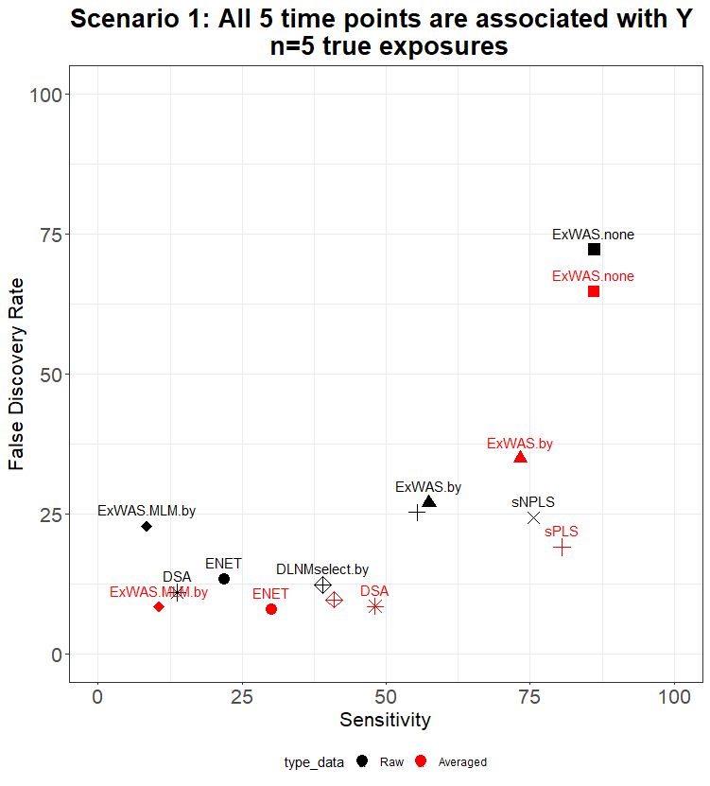
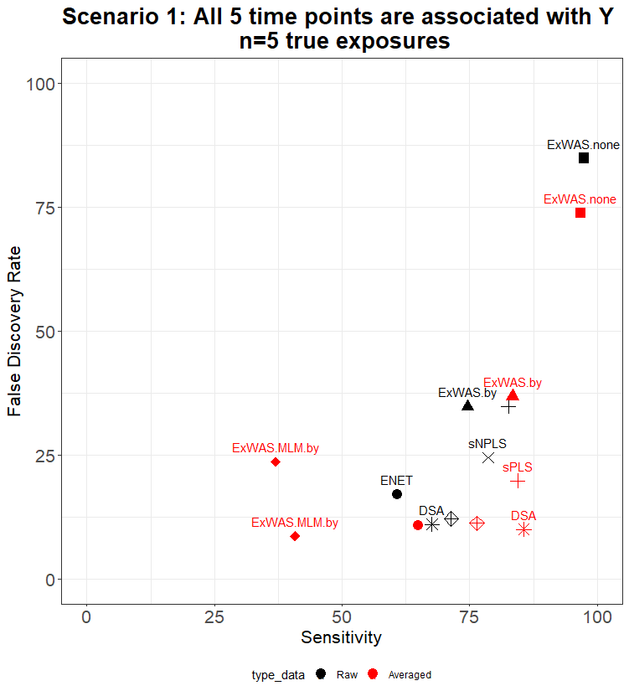
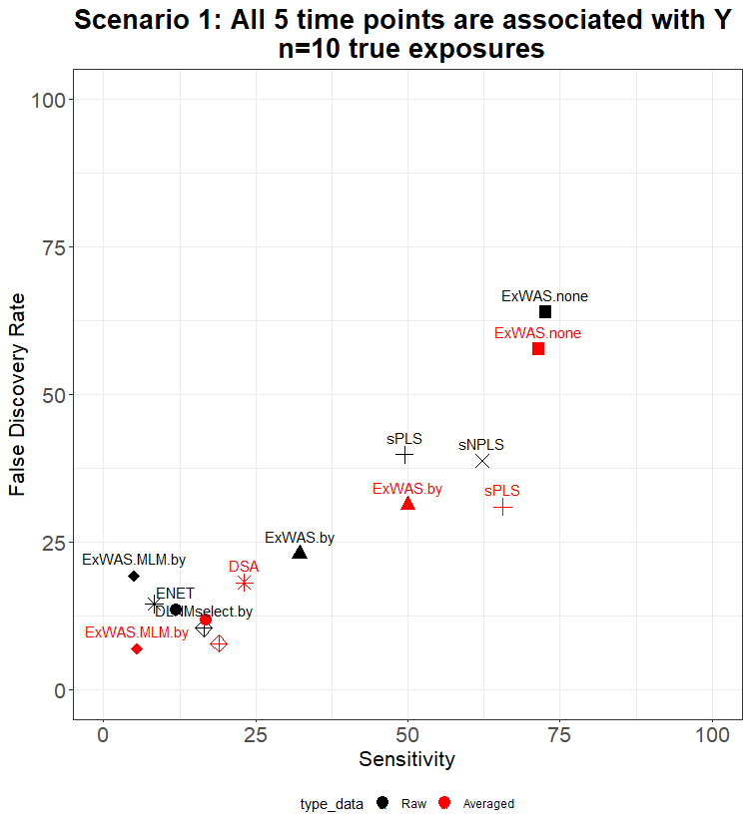
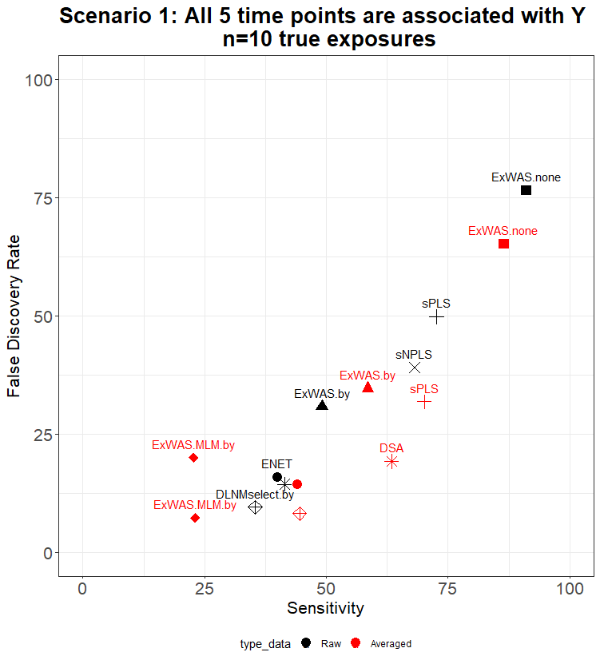
Scenario 1
Performance to identify the true exposure at the true time point
Performance to identify the true exposure whatever the time point

Slide 2
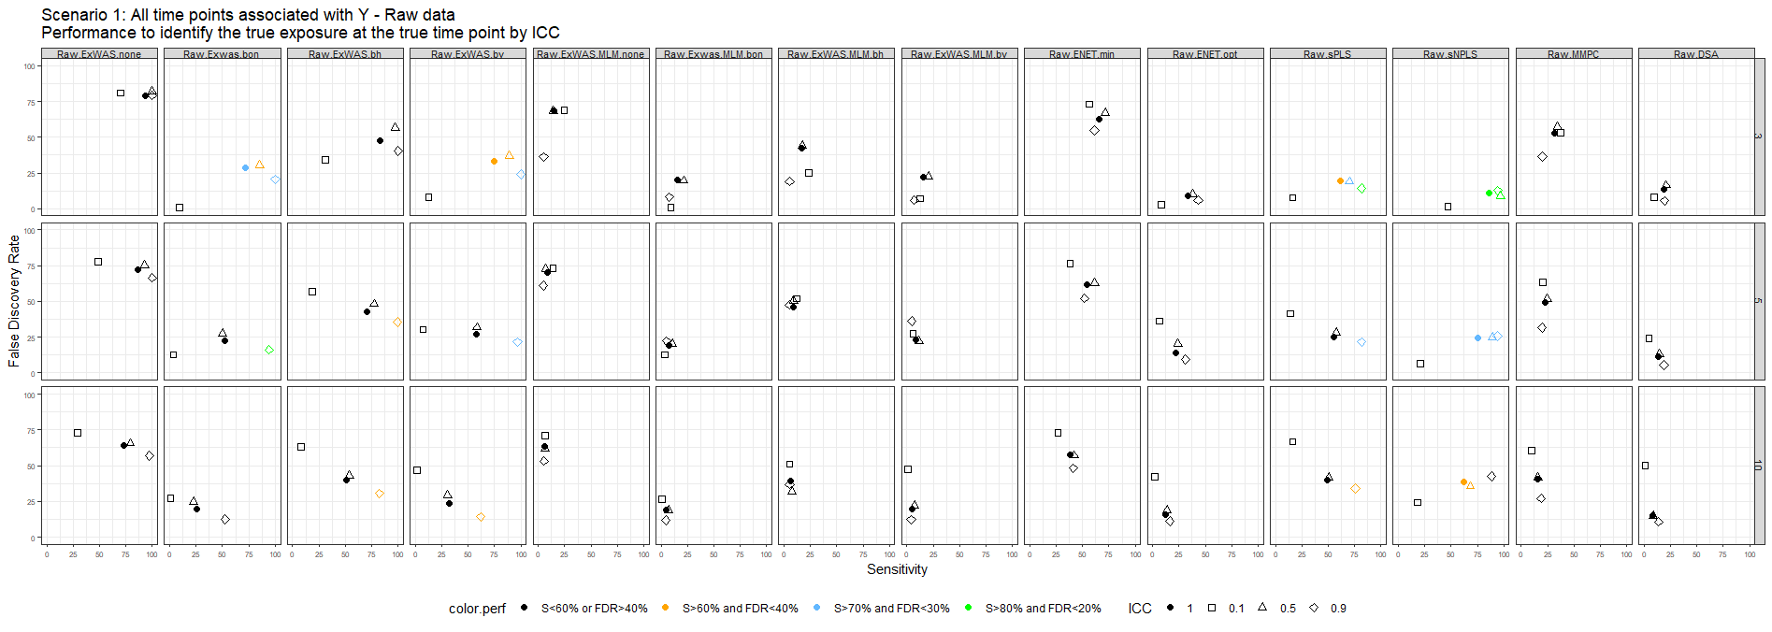
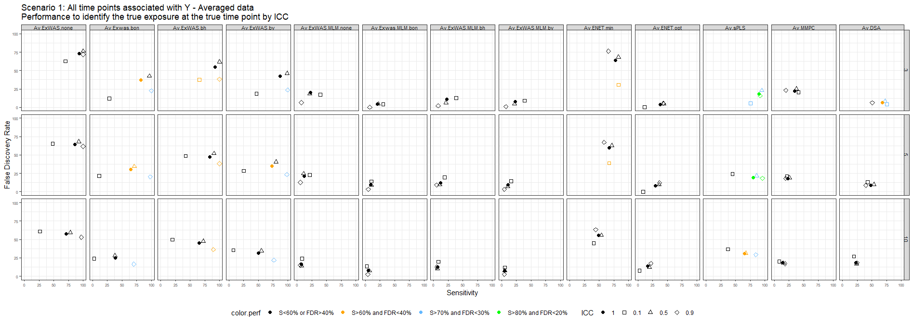
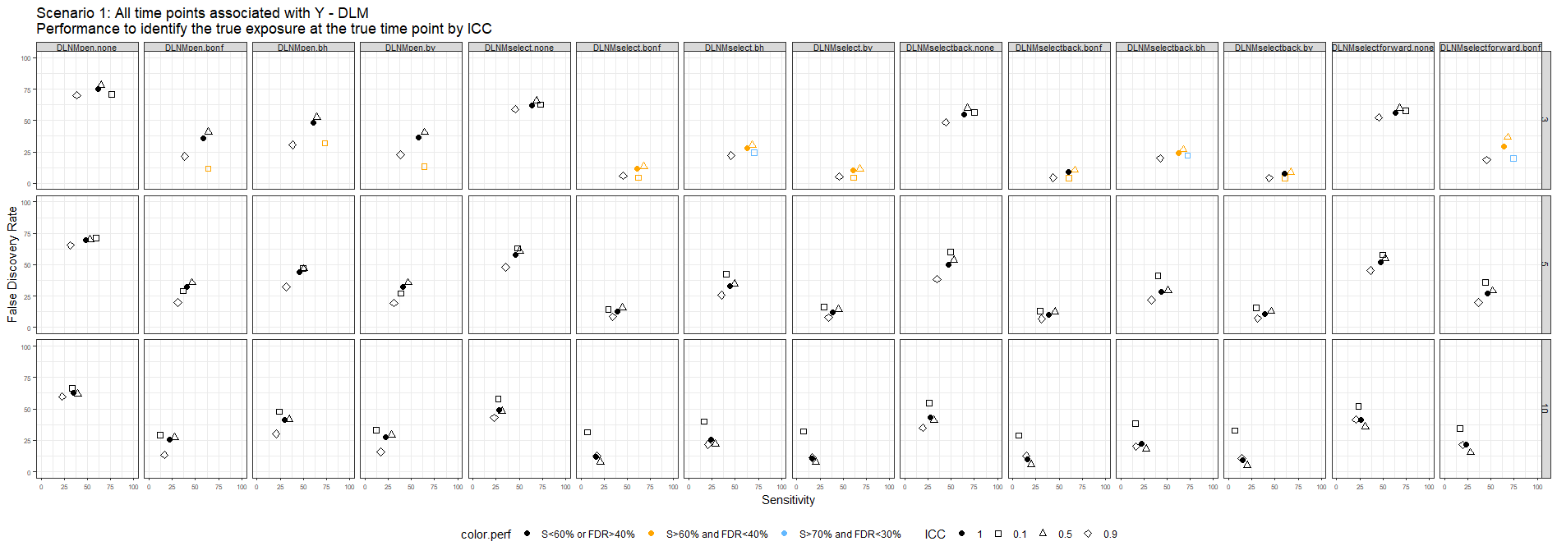
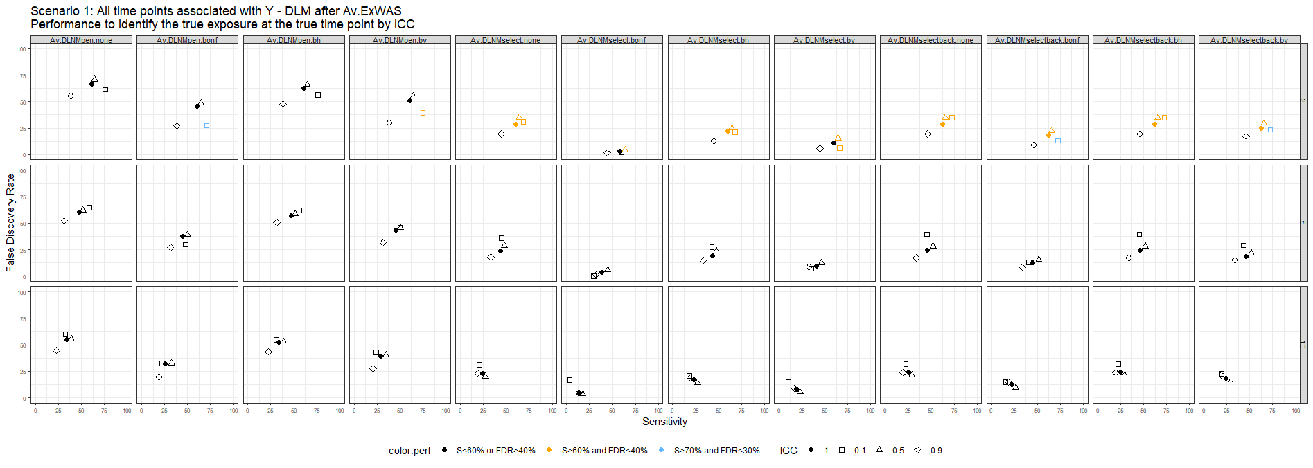
Scenario 1 – Performance to identify the true exposure at the true time point by ICC

Slide 3
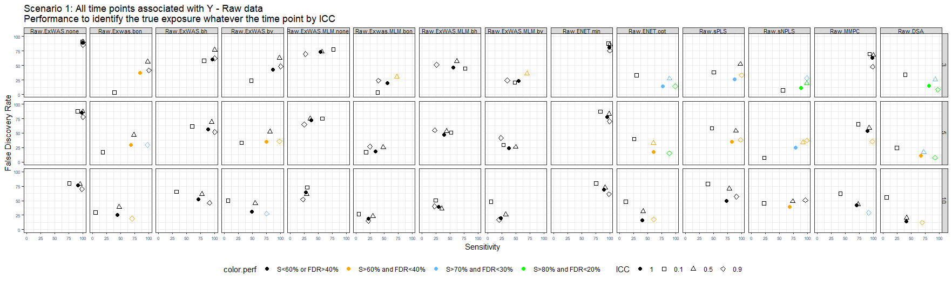
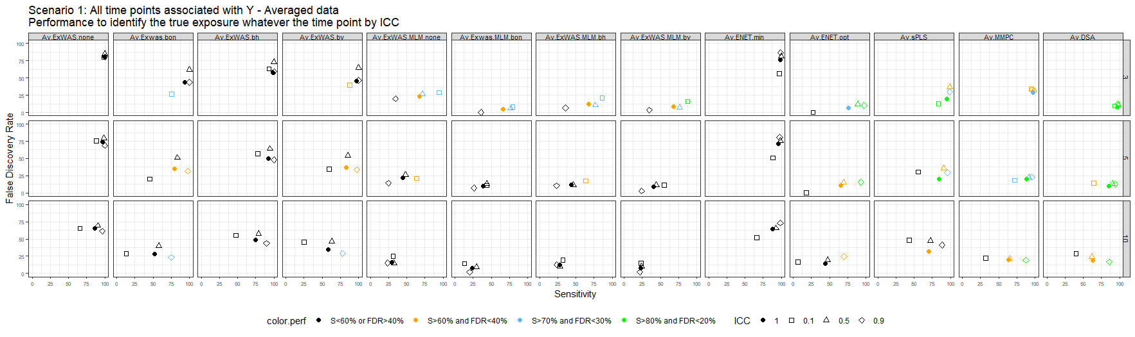
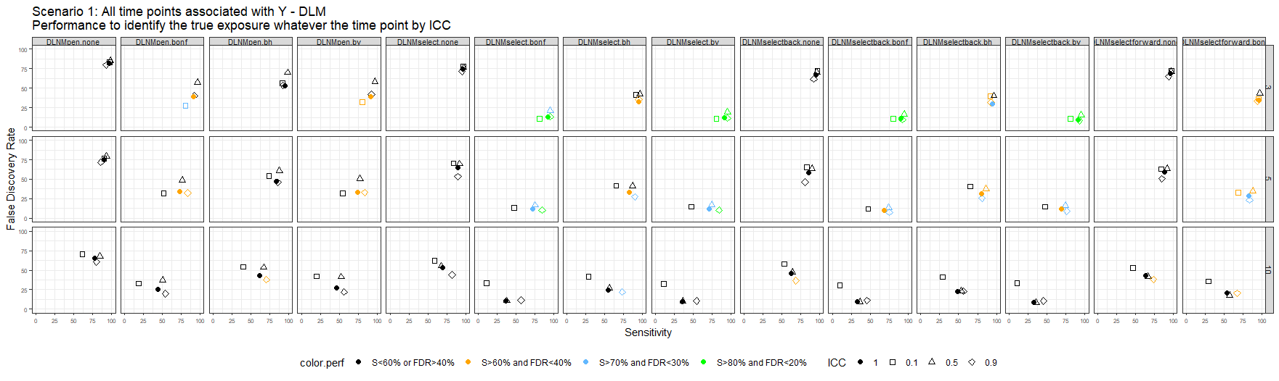
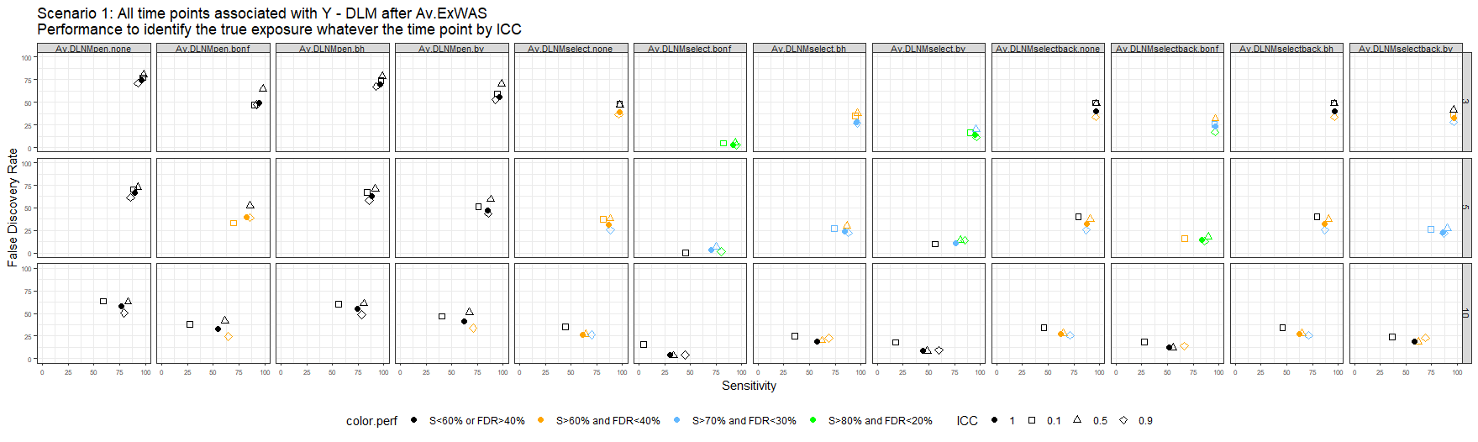
Scenario 1 – Performance to identify the true exposure whatever the time point by ICC

Slide 4
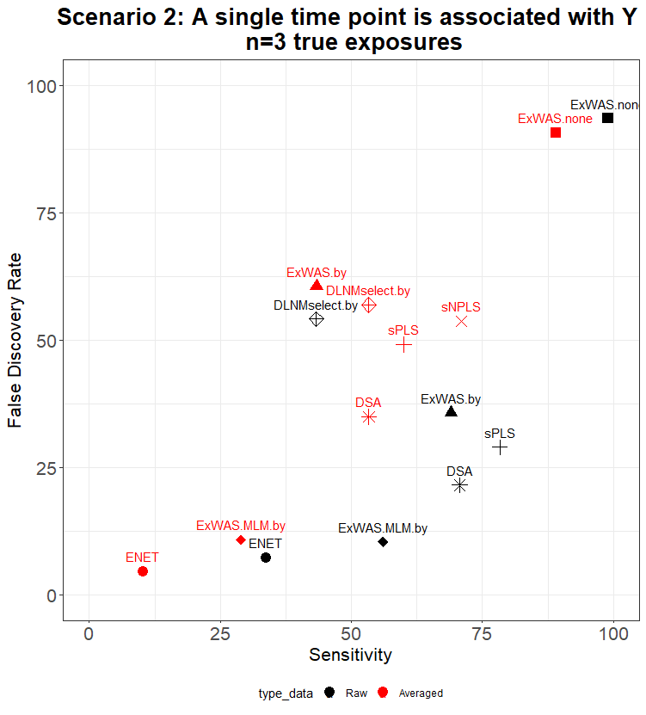
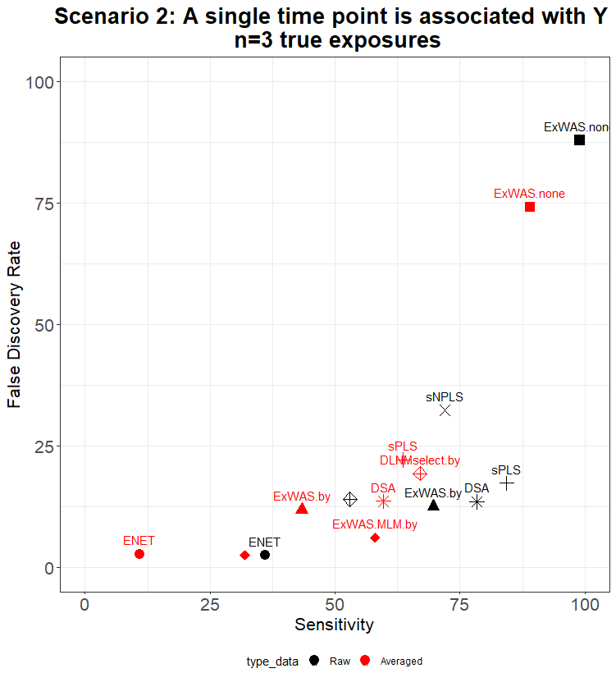
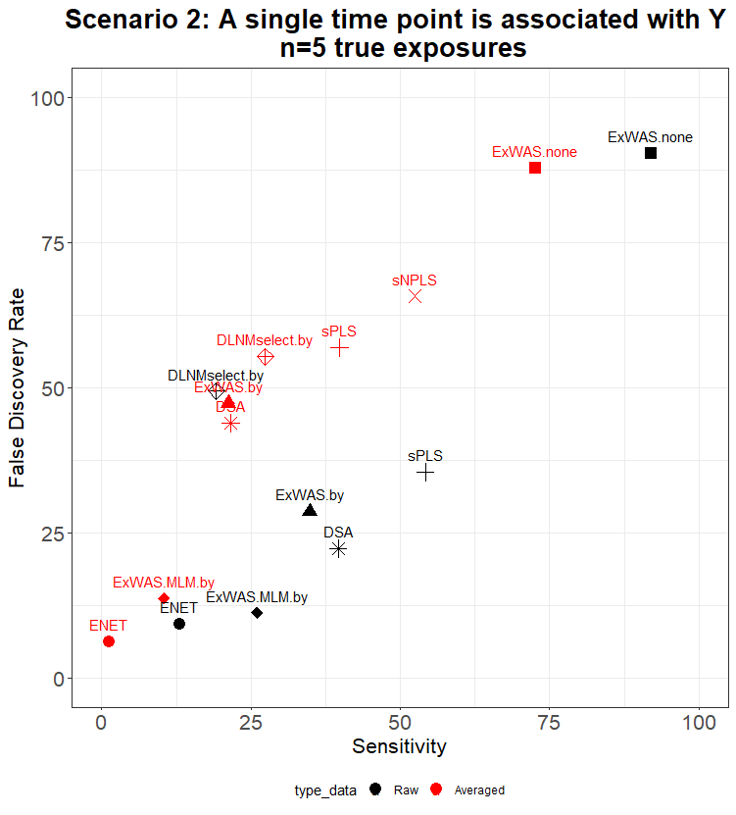
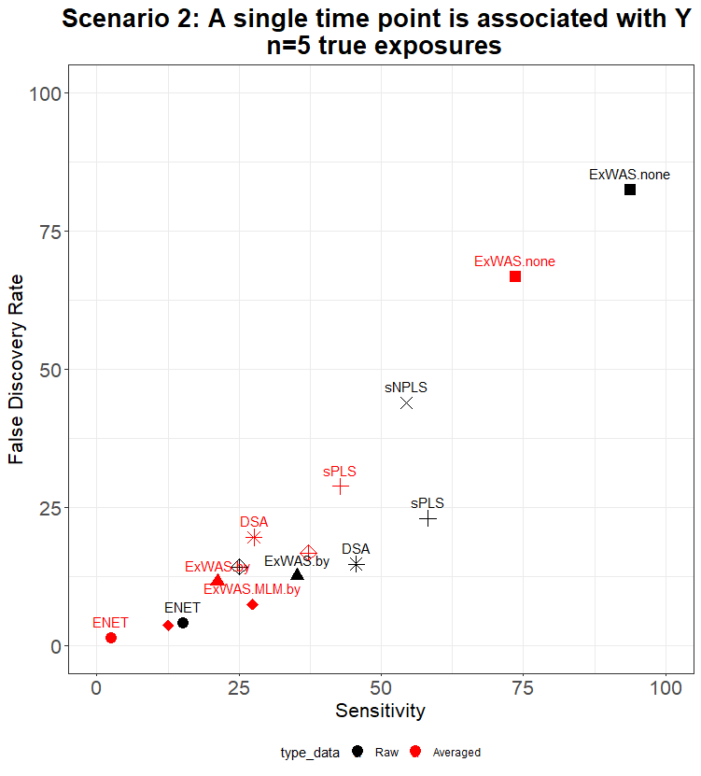
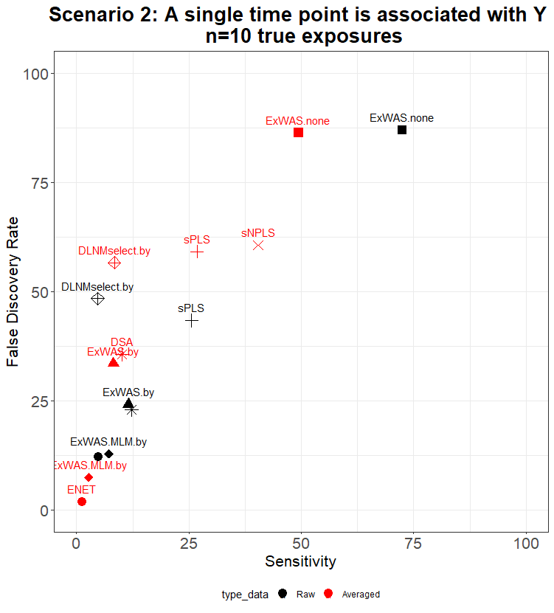
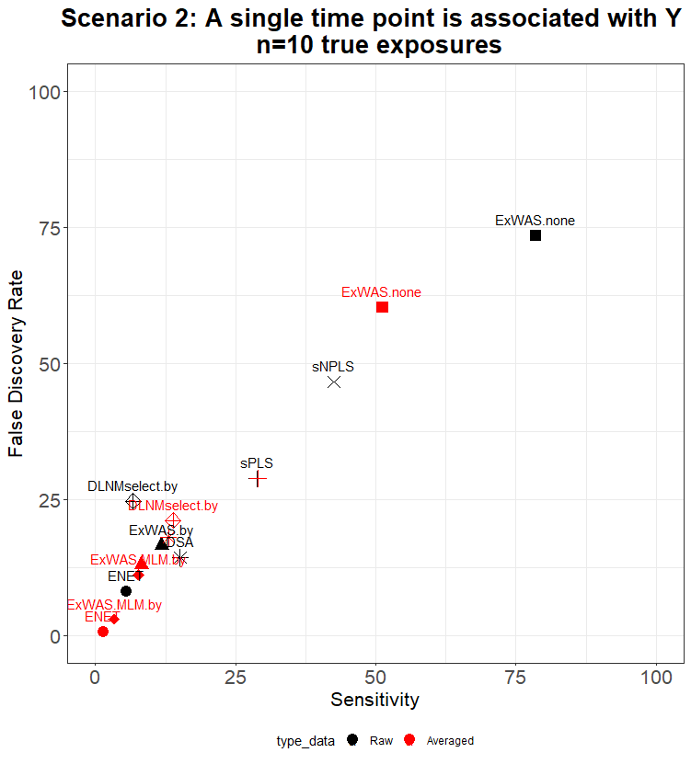
Scenario 2
Performance to identify the true exposure at the true time point
Performance to identify the true exposure whatever the time point

Slide 5
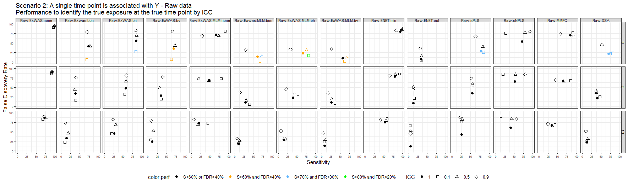
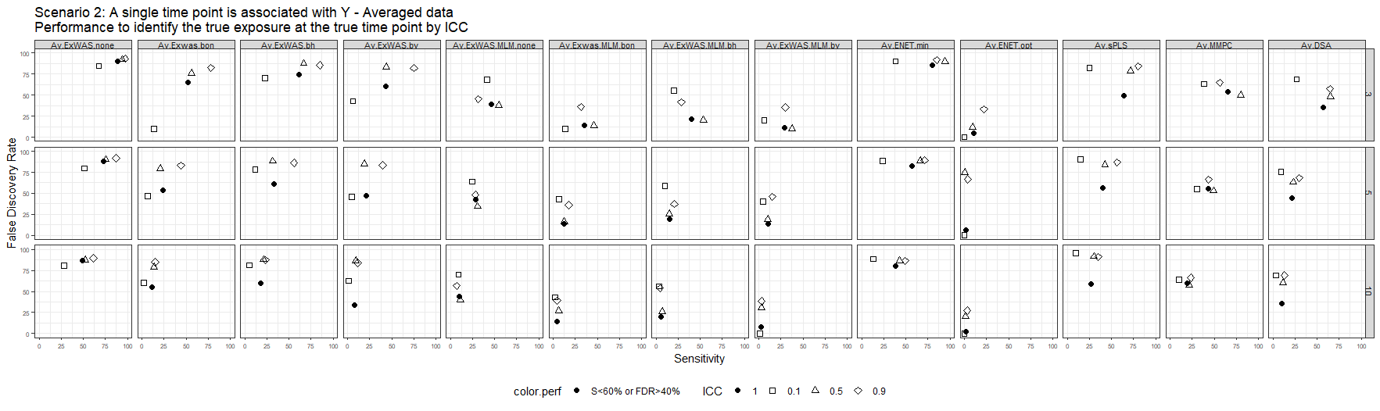
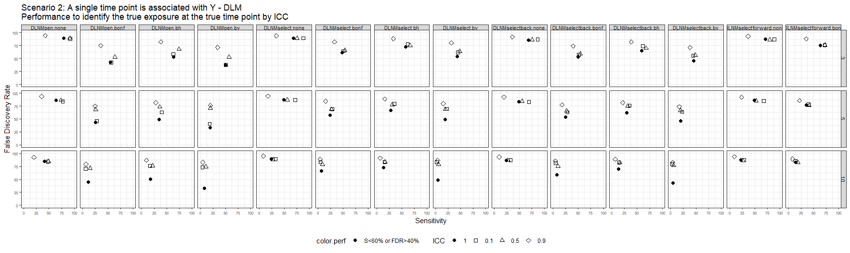
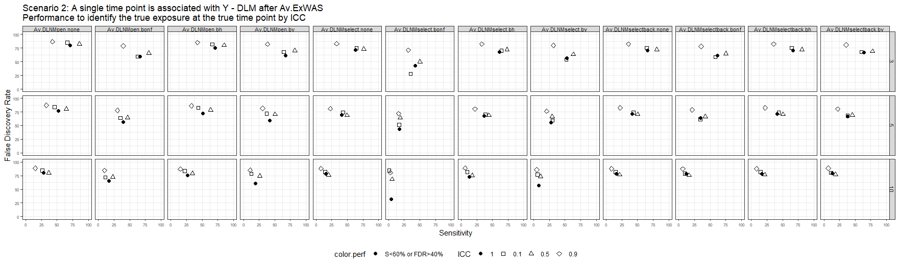
Scenario 2 – Performance to identify the true exposure at the true time point by ICC
Strange results for sPLS, sNPLS and av.sPLS: the sensitivity/FDR obtained from all exposures (ICC=1 in legend) doesn’t correspond to the ‘center’ of the sensitivity/FDR calculated by ICC (ie, the circle is not at the center of the scare, triangle and diamond)

Slide 6
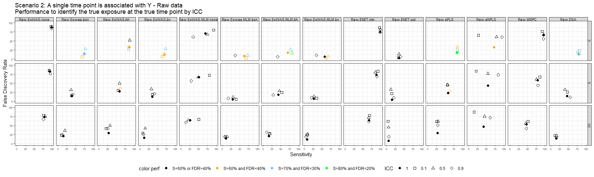
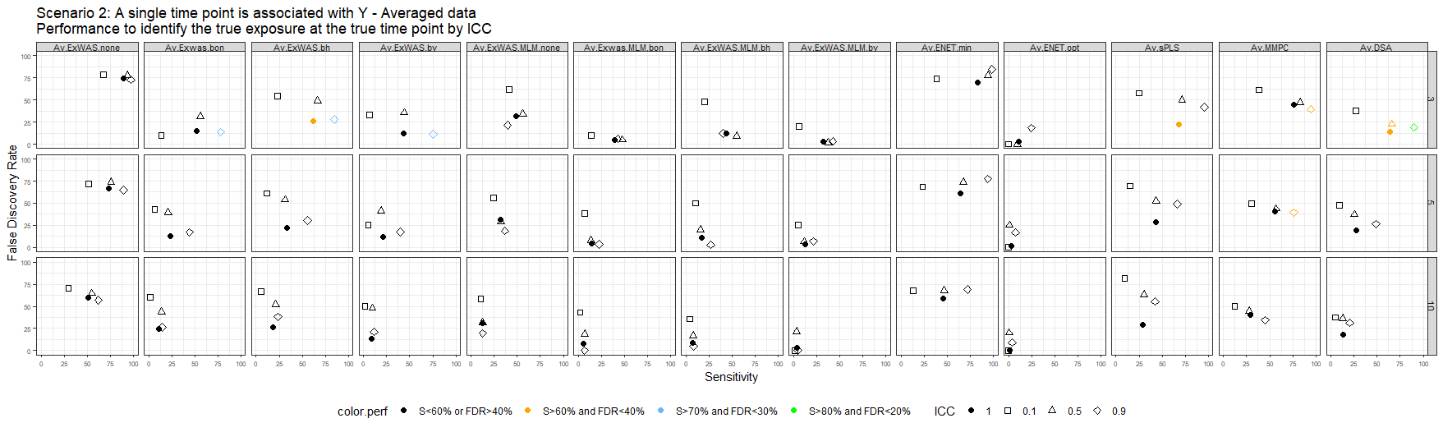
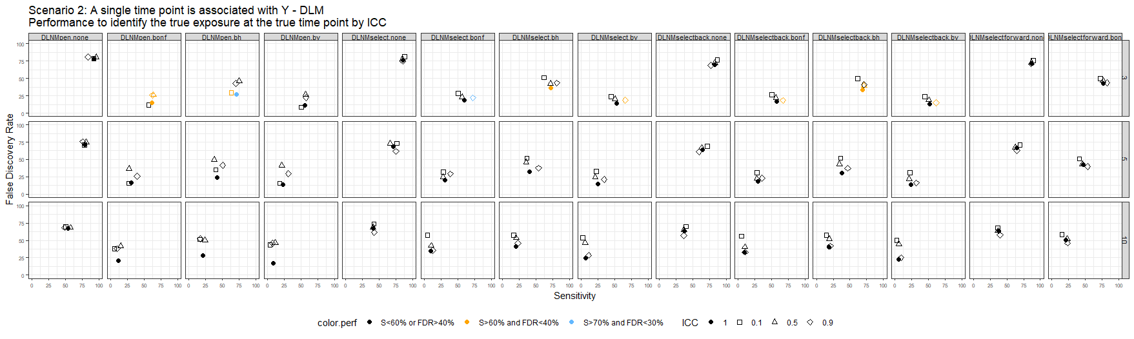
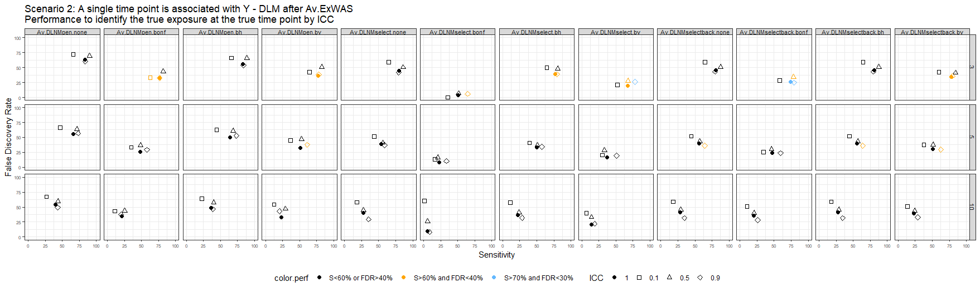
Scenario 2 – Performance to identify the true exposure whatever the time point by ICC
Strange results for sPLS, sNPLS and av.sPLS: the sensitivity/FDR obtained from all exposures (ICC=1 in legend) doesn’t correspond to the ‘center’ of the sensitivity/FDR calculated by ICC (ie, the circle is not at the center of the scare, triangle and diamond)

